Slide 1

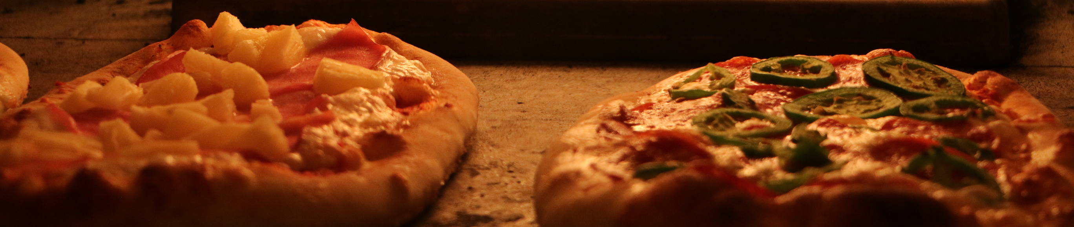
PIZZA
RESTAURANT
Sales Report Using SQL
By Shayan Anwar

Slide 2

PIZZA
RESTAURANT
ABOUT PROJECT
The Pizza Sales project helps analyze sales from different dimensions and provides the stakeholders with the necessary insights to increase revenues and elevate business growth by taking necessary actions.

Slide 3
STAKEHOLDER QUERIES
Retrieve the total number of orders placed.
Calculate the total revenue generated from pizza sales.
Identify the highest-priced pizza.
Identify the most common pizza size ordered.
List the top 5 most ordered pizza types along with their quantities.
Join the necessary tables to find the total quantity of each pizza category ordered.
Determine the distribution of orders by hour of the day.
Join relevant tables to find the category-wise distribution of pizzas.
Group the orders by date and calculate the average number of pizzas ordered per day.
Determine the top 3 most ordered pizza types based on revenue.
Calculate the percentage contribution of each pizza type to total revenue.
Analyze the cumulative revenue generated over time.
Determine the top 3 most ordered pizza types based on revenue for each pizza category.

Slide 4
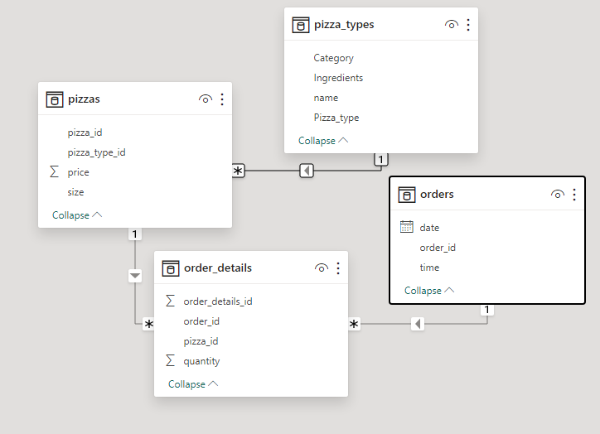
DATABASE SCHEMA
FURTHER FIND DATASET ON MY GITHUB MENTIONED IN CAPTION

Slide 5

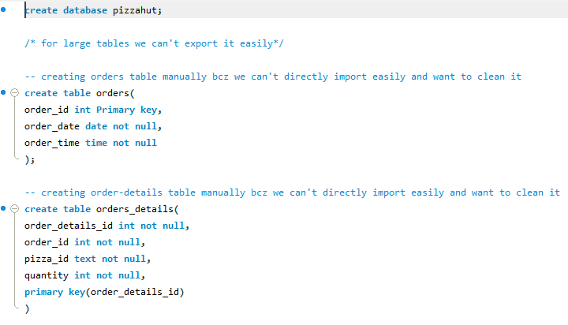
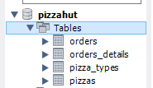

LOAD AND CLEAN TABLE

Slide 6
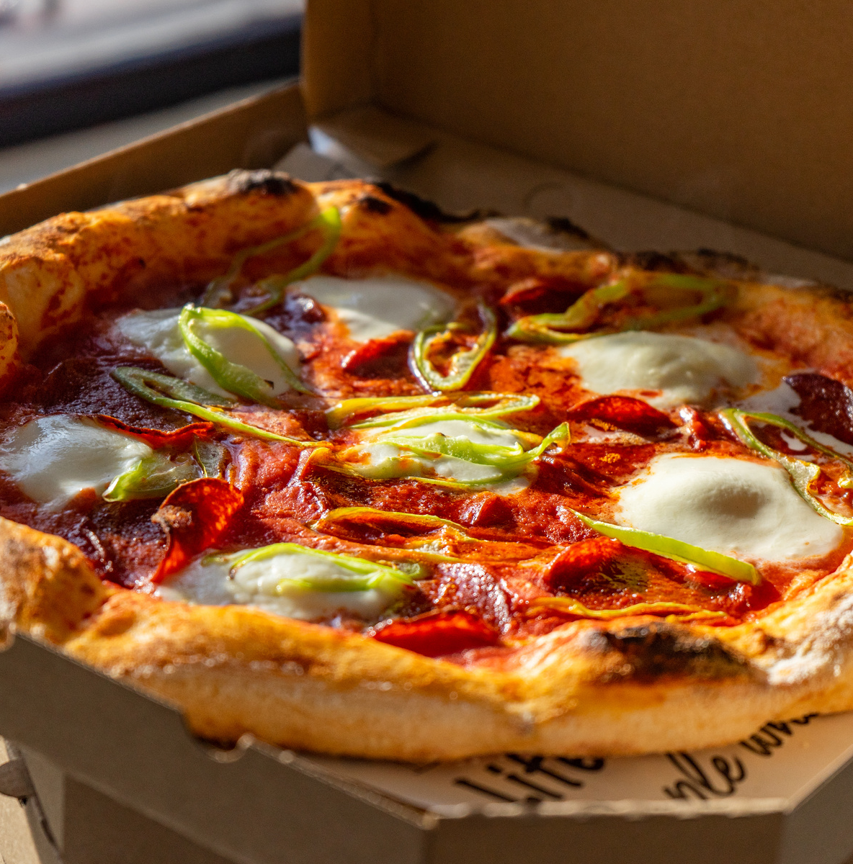
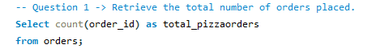
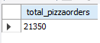
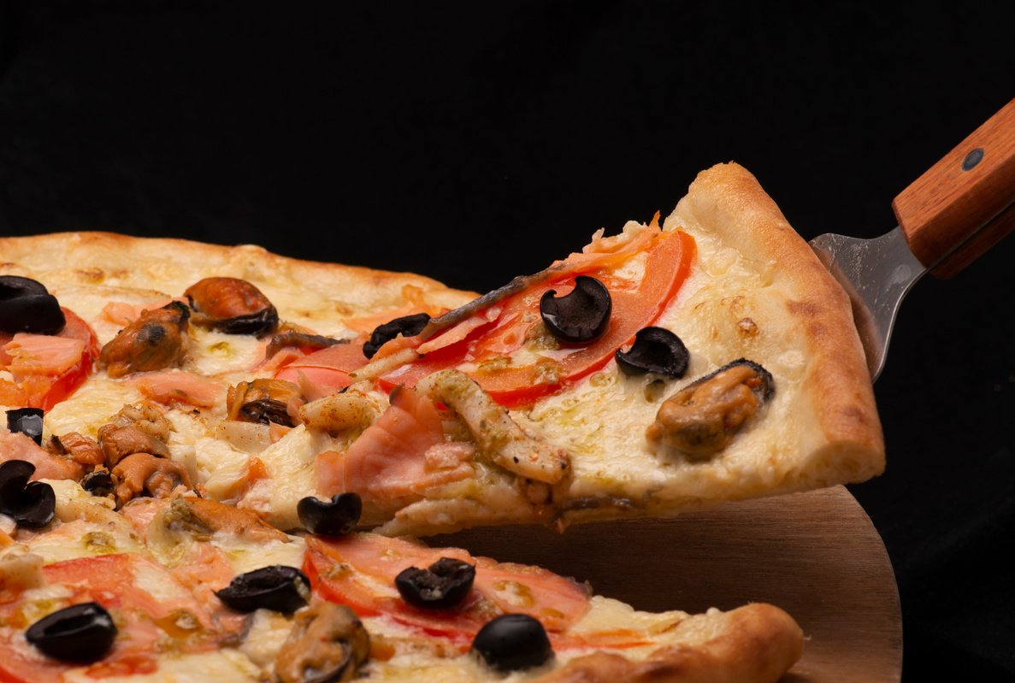
TOTAL NUMBER OF ORDERS

Slide 7
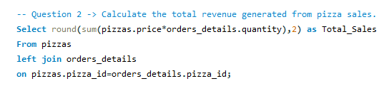
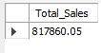
CALCULATE THE TOTAL REVENUE GENERATED FROM PIZZA SALES.

Slide 8
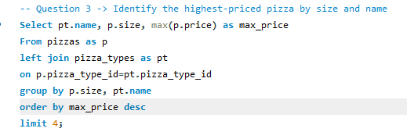
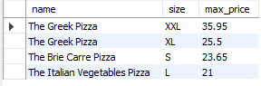
IDENTIFY THE HIGHEST-PRICED PIZZA

Slide 9
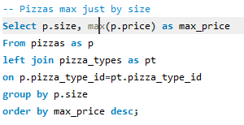
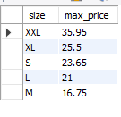
IDENTIFY THE MOST COMMON PIZZA SIZE ORDERED WITH RESPECT TO SIZE

Slide 10
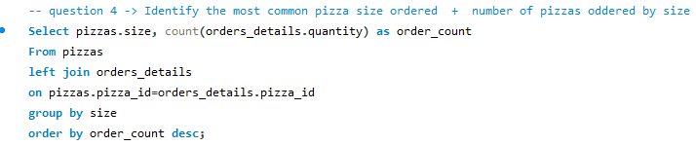
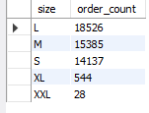
IDENTIFY THE MOST COMMON PIZZA SIZE ORDERED.

Slide 11
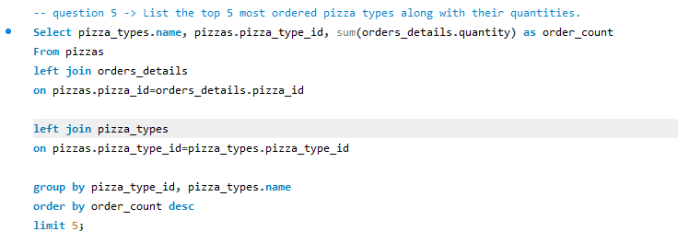
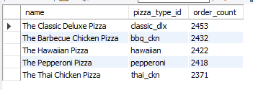
LIST THE TOP 5 MOST ORDERED PIZZA TYPES ALONG WITH THEIR QUANTITIES.

Slide 12
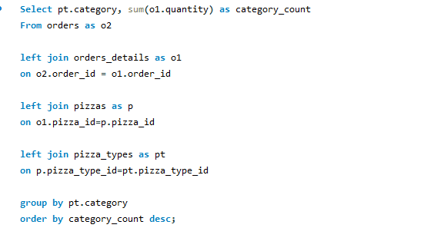
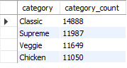
FIND THE TOTAL QUANTITY OF EACH PIZZA CATEGORY ORDERED.

Slide 13
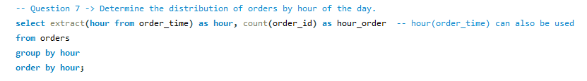
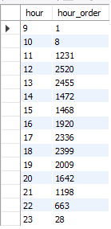
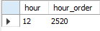
DETERMINE THE DISTRIBUTION OF ORDERS BY HOUR OF THE DAY AND HOUR WITH MOST ORDERS
BUSIEST HOUR

Slide 14
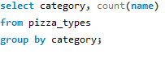

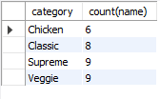
FIND THE CATEGORY-WISE DISTRIBUTION OF PIZZAS.

Slide 15
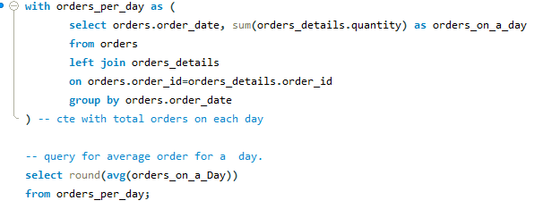
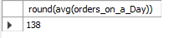
GROUP THE ORDERS BY DATE AND CALCULATE THE AVERAGE NUMBER OF PIZZAS ORDERED PER DAY.

Slide 16
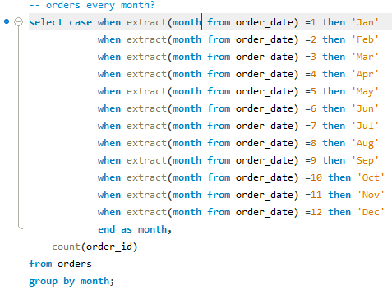
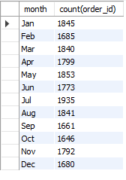

FIND ORDERS PER MONTH

Slide 17
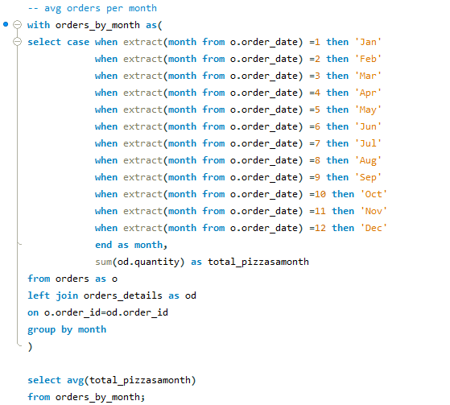
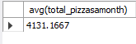
AVERAGE ORDERS PER MONTH

Slide 18
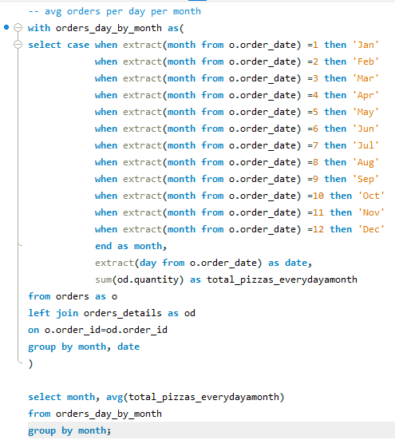
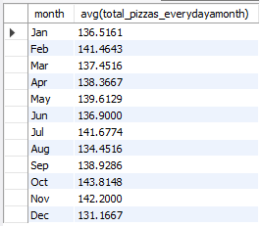
AVERAGE ORDERS PER DAY EACH MONTH

Slide 19
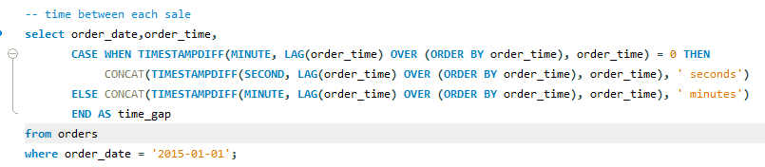
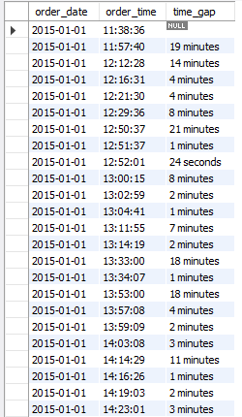
TIME BETWEEN EACH PIZZA SALE FOR 1ST JAN 2015

Slide 20
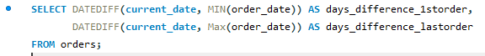
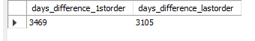
TIME PASSED BETWEEN 1ST ORDER AND THE LAST ORDER IN THE DATABASE

Slide 21
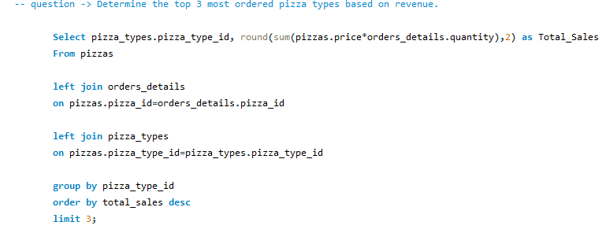
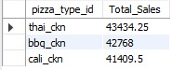

DETERMINE THE TOP 3 MOST ORDERED PIZZA TYPES BASED ON REVENUE.

Slide 22
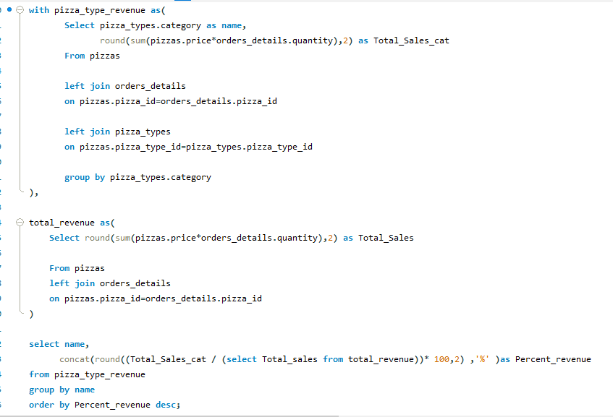
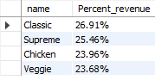
CALCULATE THE PERCENTAGE CONTRIBUTION OF EACH PIZZA TYPE TO TOTAL REVENUE.

Slide 23
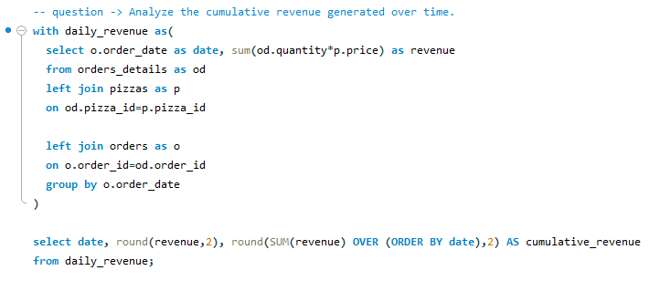

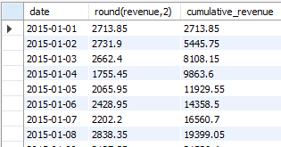
ANALYZE THE CUMULATIVE REVENUE GENERATED OVER TIME.

Slide 24
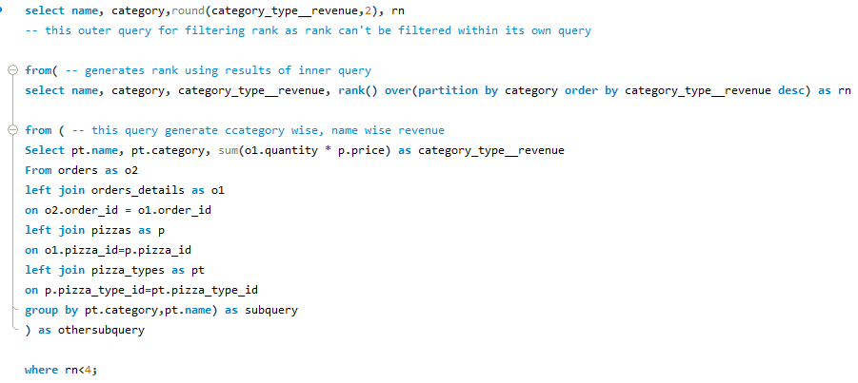
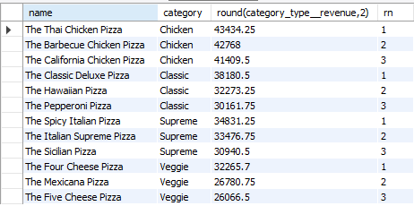
DETERMINE THE TOP 3 MOST ORDERED PIZZA TYPES BASED ON REVENUE FOR EACH PIZZA CATEGORY.

Slide 25


CONTACT ME
Empower your Business Decisions with Stats and Numbers
+92 313-3239067
theshayansway2@gmail.com
Karachi, Pakistan

Slide 26
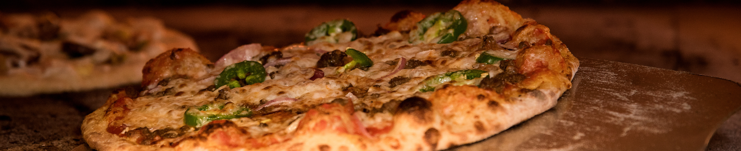
PIZZA
RESTAURANT
THANK YOU

